Slide 1

Early Detection of Alzheimer's Disease Through Pattern Recognition
Name | ID
Sazid Hasan Tonmoy | 23241037
Nowrin Tasnim Moon | 23266010
Afreen Rahman Tithi | 18101303
ST: Mehnaz Ara Fazal
RA: Sania Azhmee Bhuiyan
Group: 02

Slide 2
Abstract
Objective: Detect early Alzheimer's using pattern recognition on a dataset of 6400 preprocessed MRI images
Dataset categories: Mild Demented, Moderate Demented, Non-Demented, Very Mild Demented
Algorithms: Random Forest, SVM, CNN, LSTM
Performance: Random Forest and SVM show strong classification; CNN captures complex patterns
Study goal: Evaluate algorithm efficacy in early AD detection, providing insights into strengths and limitations
Contribution: Advances AD diagnostics, underscores importance of early detection for better outcomes

Slide 3
Introduction
Alzheimer's Disease (AD)
Neurodegenerative disorder affecting the brain
Leads to memory loss, cognitive decline, and functional impairment
Progressive and irreversible, impacting daily life activities
Prevalent in aging populations, with no current cure
MRI (Magnetic Resonance Imaging)
Non-invasive imaging technique
Provides detailed structural information about the brain
Uses magnetic fields and radio waves to create high-resolution images
Essential for studying brain anatomy and detecting abnormalities

Slide 4
Research Problem
Late Identification
Current methods often detect Alzheimer's Disease at advanced stages, impeding timely interventions.
Limited Sensitivity
Existing approaches may miss subtle early-stage AD indicators, hindering accurate diagnosis.
Integration Challenge
Explore integrating pattern recognition with MRI data to enhance early AD detection accuracy.

Slide 5
Research Motivation & Objective
Significant Impact of Alzheimer's Disease (AD)
Danger of Late-Stage Diagnoses
Advancements in Imaging
Machine Learning (ML) Potential
Multimodal Approach
Clinical and Social Impact
Closing Research Gap
In summary, our objective is to leverage cutting-edge technologies to revolutionize early Alzheimer's Disease detection, ultimately improving patient outcomes and addressing current diagnostic challenges.

Slide 6
Early Detection through Pattern Recognition
Objective: Detect early signs of Alzheimer's disease before significant cognitive decline
Data Source: Analyze a curated dataset of 6400 preprocessed MRI images, categorized into Mild Demented, Moderate Demented, Non-Demented, and Very Mild Demented
Algorithmic Approach: Use Three algorithms—Random Forest, SVM, CNN
Pattern Recognition: Algorithms identify patterns indicative of early-stage Alzheimer's. Random Forest and SVM focus on classification, while CNN captures intricate patterns in both image and sequential data
Evaluation: Assess algorithm effectiveness in early Alzheimer's detection, providing insights into strengths and limitations
Significance: Emphasize the crucial role of early detection for improved patient outcomes, contributing to advancements in diagnostic capabilities for Alzheimer's disease

Slide 7
Methodology
Random Forest Model
Flatten dataset
Train RandomForestClassifier (100 estimators)
Evaluate accuracy, confusion matrix, and classification report
Support Vector Machine (SVM) Model
Use flattened dataset for training and prediction
Assess accuracy, confusion matrix, and classification report
Convolutional Neural Network (CNN) Model
Build CNN with convolutional, pooling, and dense layers
Compile with Adam optimizer, sparse categorical cross-entropy loss
Train for 10 epochs

Slide 8
Literature Review
Paper | Algorithm | Data Type | Pros | Cons
Early detection of Alzheimer's disease using single nucleotide polymorphisms analysis based on gradient boosting tree (2022) | Gradient Boosting Tree (GBT) | Whole-genome SNPs | - High accuracy (99.06%) - Detected most AD-associated SNPs | - Requires large datasets - Limited interpretability
Revolutionizing the Early Detection of Alzheimer's Disease through Non-Invasive Biomarkers: The Role of Artificial Intelligence and Deep Learning (2023) | PETNet (Deep Learning) | PET scan images | - Non-invasive and accessible data type - High accuracy in early detection of AD | - Requires advanced computing resources - Black-box nature, difficult to interpret results
Early Detection of Alzheimer's Disease Using Magnetic Resonance Imaging: A Novel Approach Combining Convolutional Neural Networks and Ensemble Learning (2020) | Convolutional Neural Network (CNN) + Ensemble Learning | MRI scans | Identifies brain regions associated with AD Performs well in classifying AD vs. healthy controls | - Requires large datasets of MRI scans - Complex architecture, challenging to modify
A new strategy for the early detection of alzheimer disease stages using multifractal geometry analysis based on K-Nearest Neighbor algorithm (2022) | K-Nearest Neighbors (KNN) | EEG signals | - Can distinguish early AD stages - Simple and computationally efficient | - Sensitive to noise in EEG data - Not effective for all types of EEG data

Slide 9
Literature Review
Paper | Algorithm | Data Type | Pros | Cons
Recursive Support Vector Machine Biomarker Selection for Alzheimer's Disease (SVM-RFE-LOO) (2022) | SVM | MRI | - High accuracy in distinguishing AD from healthy controls and MCI - Identifies relevant brain regions for diagnosis | - Requires large datasets for training - May not generalize well to different datasets
Early Detection of Alzheimer’s Disease From Cortical and Hippocampal Local Field Potentials Using an Ensembled Machine Learning Model (2023) | Ensembled ML Model ( MLP, LSTM, LSTM-CNN, and EEGNET) | Local Field Potentias (LFPs) | - High sensitivity and specificity in identifying AD - Non-invasive and readily available data | - Requires specialized software and hardware - model evaluated on non-human dataset
Early detection of Alzheimer's disease using resting-state functional magnetic resonance imaging (rs-fMRI) and graph-based semi-supervised learning (GSSL) (2021) | GSSL | rs-fMRI | - Effective in identifying early-stage AD with limited labeled data - Explores functional connectivity patterns in the brain | - Requires specialized preprocessing and analysis of rs-fMRI data - May be less accurate than supervised learning methods
Classification of Alzheimer's disease using electroencephalogram (EEG) signals and a hybrid machine learning approach (2020) | Hybrid (K-means clustering + Random Forest) | EEG | - Affordable and portable data acquisition - Identifies different subtypes of AD with moderate accuracy | - EEG signals are susceptible to noise and individual variations - Requires careful feature engineering and selection
A gene expression pattern in blood for the early detection of Alzheimer's disease (2019) | Jackknife gene selection based method & Partial Least Square Regression (PLSR) | Blood Gene Expression | - accuracy 87%, sensitivity 84% and specificity 91%, ROC AUC 0.94 - Identifies potential biomarkers for early diagnosis | - Requires high-quality gene expression data - May not be applicable to all AD cases due to individual variability

Slide 10
Data Collection & Preprocessing
Data Acquisition
Utilized the Preprocessed Alzheimer's MRI dataset
Resized images to a uniform 224x224 pixels
Normalized pixel values to [0, 1]
Applied specific preprocessing for each model type (flattening, reshaping)
Image Resizing
Utilized OpenCV for uniform resizing of images to 224x224 pixels
Normalization
Standardized pixel values to a range of [0, 1] for consistent input
Skull Stripping
Applied skull stripping during preprocessing to enhance image quality and isolate relevant brain structures
Data Augmentation (for CNN)
Applied shear, zoom, and horizontal flip techniques to enhance CNN training set diversity

Slide 11
Data Collection & Preprocessing
Flattening (for Random Forest and SVM)
Flattened images into one-dimensional arrays for compatibility with Random Forests and SVM models
Dataset Combination
Combined data from various dementia stages into a unified dataset, ensuring diversity, and introduced shuffling for improved model training robustness

Slide 12
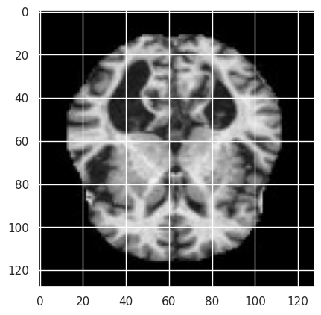
Data Collection & Preprocessing
Fig: Sample MRI Image of Mild Dementia Class

Slide 13
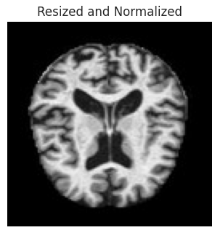
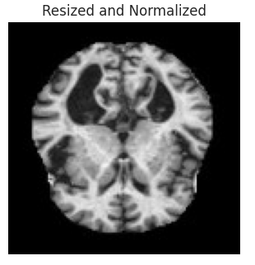
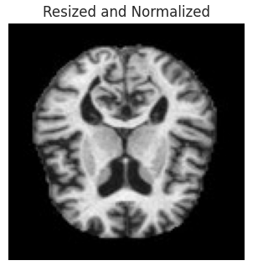
Data Collection & Preprocessing
Fig: Resized and Normalized MRI Images of Mild Dementia Class

Slide 14
Methodology
Model Training and Evaluation:
Employed machine learning models:
Random Forests
Support Vector Machines (SVM)
Convolutional Neural Networks (CNN)
Split dataset into training and testing sets
Applied Data Augmentation for CNN training
Configured early stopping to prevent overfitting during CNN training
Performance Evaluation:
Assessed model performance using standard metrics:
Precision
Recall
F1-Score
Confusion matrices with Heatmaps for visualization

Slide 15
Methodology: Traditional Algorithm
Random Forest
Algorithm: Random Forest Classifier
Hyperparameters:
n_estimators: 100
random_state: 42
Support Vector Machine (SVM)
Algorithm: Support Vector Machine (SVM)
Hyperparameters:
kernel: linear
C: 1

Slide 16
Methodology: Convolutional Neural Network (CNN)
Architecture:
Convolutional Layer 1:
Filters: 32
Kernel Size: (3, 3)
Activation: 'relu'
MaxPooling Layer 1:
Pool Size: (2, 2)
Convolutional Layer 2:
Filters: 64
Kernel Size: (3, 3)
Activation: 'relu'
MaxPooling Layer 2:
Pool Size: (2, 2)
Convolutional Layer 3:
Filters: 64
Kernel Size: (3, 3)
Activation: 'relu'
Flatten Layer
Dense Layer:
Neurons: 64
Activation: 'relu'
Output Layer:
Neurons: 3 (for classification)
Activation: 'softmax'
Compilation:
Optimizer: 'adam'
Loss: 'sparse_categorical_crossentropy'

Slide 17
Experimental Setup
Hardware Configuration
Processor: Intel Core i7-6700k
Ram: 3200 MHz 16 GB RAM
GPU: GTX 1660 Ti
Storage: 2TB WD Blue 7200rpm HDD
Operating System: Windows 10 Pro
Software Environment
Kaggle platform
Language: Python
GPU Accelerator: T4x2 Configuration
GPU acceleration significantly reduced training time for DL models
Experimental Focus
Comprehensive experimentation for the early detection of Alzheimer's disease through pattern recognition
Thorough investigation of various machine learning and deep learning models

Slide 18
Result Analysis
The Random Forest classifier achieved an accuracy of 92%, with detailed metrics like precision, recall, and F1-score providing insights into its performance.
The SVM model exhibited outstanding performance with an accuracy of 99%, showcasing its ability to distinguish between different disease stages. Evaluation metrics, confusion matrix, and heatmap further validated its robustness.
CNN model achieved competitive accuracy of 90% and tuning the hyper-parameters can further optimize its performance

Slide 19
Result Analysis
Table 01: Random Forest Classification Report
 | Precision | Recall | F1-Score | Support
Non-Demented | 0.91 | 1.00 | 0.95 | 643
Mild Dementia | 1.00 | 0.72 | 0.83 | 201
Moderate Dementia | 1.00 | 1.00 | 1.00 | 6
Very Mild Dementia | 0.91 | 0.90 | 0.91 | 430
Accuracy |  |  | 0.92 | 1280
Macro Avg | 0.96 | 0.90 | 0.92 | 1280
Weighted Avg | 0.93 | 0.92 | 0.92 | 1280

Slide 20
Result Analysis
Table 02: SVM Classification Report
 | Precision | Recall | F1-Score | Support
Non-Demented | 0.98 | 1.00 | 0.99 | 643
Mild Dementia | 1.00 | 0.99 | 0.99 | 201
Moderate Dementia | 1.00 | 1.00 | 1.00 | 6
Very Mild Dementia | 0.99 | 0.97 | 0.98 | 430
Accuracy |  |  | 0.99 | 1280
Macro Avg | 0.99 | 0.99 | 0.99 | 1280
Weighted Avg | 0.99 | 0.99 | 0.99 | 1280

Slide 21
Result Analysis
Table 03: CNN Classification Report
 | Precision | Recall | F1-Score | Support
Non-Demented | 0.96 | 0.87 | 0.91 | 624
Mild Dementia | 0.87 | 0.90 | 0.88 | 192
Moderate Dementia | 1.00 | 1.00 | 1.00 | 13
Very Mild Dementia | 0.84 | 0.94 | 0.89 | 451
Accuracy |  |  | 0.90 | 1280
Macro Avg | 0.92 | 0.93 | 0.92 | 1280
Weighted Avg | 0.90 | 0.90 | 0.90 | 1280

Slide 22
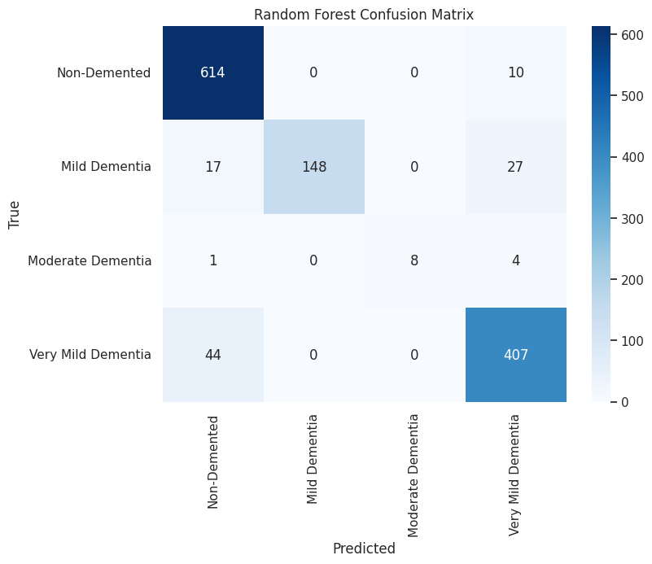
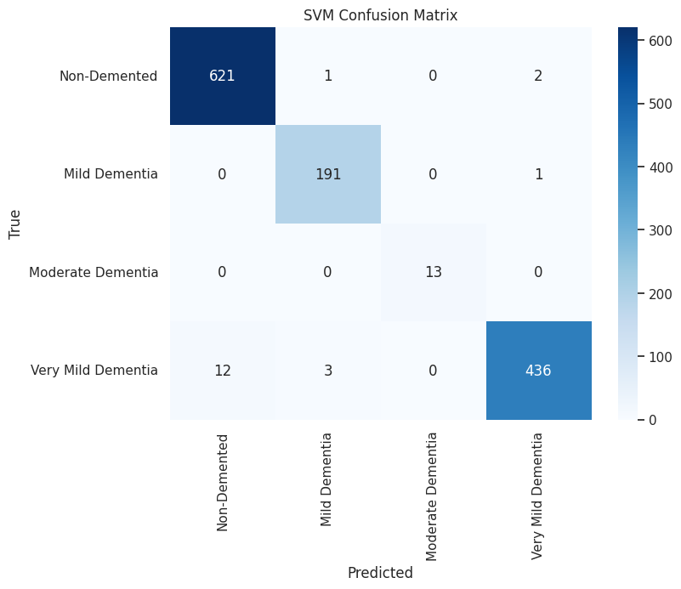
Result Analysis
Fig: Confusion Matrix Heatmap of RF & SVM Respectively

Slide 23
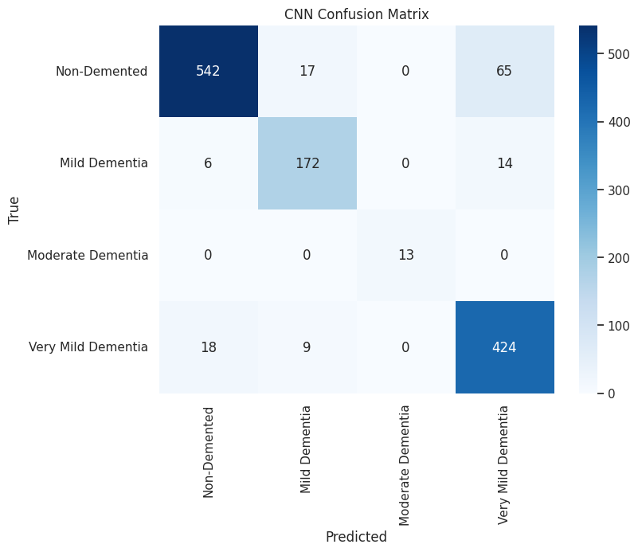
Result Analysis
Fig: Confusion Matrix Heatmap of CNN

Slide 24
Discussion
Random Forest Model:
Overall accuracy: 92%
Strong performance for Non-Demented (F1-score: 0.94)
Challenges in identifying Mild Dementia and Moderate Dementia
Confusion between Classes Non-Demented and Very Mild Dementia
SVM Model:
Impressive accuracy: 99%
Near-perfect precision, recall, and F1-scores for all classes
Minimal instances of misclassification
Robust performance for early detection
CNN Model:
Overall accuracy: 90%
High precision and recall for Moderate Dementia
Challenges in identifying Non-Demented and Mild Dementia
Struggles with distinguishing between Non-Demented and Very Mild Dementia

Slide 25
Challenges & Shortcomings
Data Quality and Availability
Dataset Size
Data Variability
Sensitivity to Image Quality and Resolution
Data Privacy Concerns
Class Imbalance and Minority Class Identification
Confusion Between Specific Classes
Algorithmic Challenges
Feature Selection and Representation
Model Explainability and Interpretability
Handling Multi-Class Classification
Generalization to Real-World Data
Spatial Pattern Recognition Limitations
Interpretability of Misclassifications

Slide 26
Challenges & Shortcomings
Hardware Constraints
Limited Computing Power
GPU Unavailability
Scalability Issues
Outdated Hardware Infrastructure
Clinical Translation and Validation
Validation in Large-Scale Studies
Integration into Clinical Workflow
Limited Generalization Across Diverse Populations
User Acceptance and Trust
Ethical and Societal Implications

Slide 27
Future Work
Focus on enhancing models' performance, especially for minority classes
Investigate interpretability of models and salient features
Fine-Tuning CNN Architectures
Ensemble Methods Integration
Explainability Strategies
Population-Specific Models
Multi-Modal Fusion
Continuous Model Monitoring
Collaboration with Clinical Experts
Validation on External Datasets
Longitudinal Studies

Slide 28
Conclusion
In embarking on this project for the "Early Detection of Alzheimer's Disease through Pattern Recognition" we recognize the immense potential and the challenges that exist on this journey. Our comprehensive work integrates advanced machine learning algorithms, a diverse dataset, and cutting-edge imaging technologies to address the critical need for early detection in Alzheimer's Disease.

Slide 29
Thank You

Slide 30
Bibliography
Ahmed, Hala, Hassan Soliman, and Mohammed Elmogy. "Early detection of Alzheimer's disease using single nucleotide polymorphisms analysis based on gradient boosting tree." Computers in Biology and Medicine 146 (2022): 105622.
Elgammal, Yasmina M., M. A. Zahran, and Mohamed M. Abdelsalam. "A new strategy for the early detection of alzheimer disease stages using multifractal geometry analysis based on K-Nearest Neighbor algorithm." Scientific Reports 12.1 (2022): 22381.
Vrahatis, Aristidis G., et al. "Revolutionizing the Early Detection of Alzheimer’s Disease through Non-Invasive Biomarkers: The Role of Artificial Intelligence and Deep Learning." Sensors 23.9 (2023): 4184.
Pan, Dan, et al. "Early detection of Alzheimer’s disease using magnetic resonance imaging: a novel approach combining convolutional neural networks and ensemble learning." Frontiers in neuroscience 14 (2020): 259.
Kishore, P., et al. "Detection and analysis of Alzheimer’s disease using various machine learning algorithms." Materials today: proceedings 45 (2021): 1502-1508.

Slide 31
Bibliography
Zhang, Fan, et al. "Recursive support vector machine biomarker selection for Alzheimer’s disease." Journal of Alzheimer's Disease 79.4 (2021): 1691-1700.
Booij, Birgitte Boonstra, et al. "A gene expression pattern in blood for the early detection of Alzheimer's disease." Journal of Alzheimer's Disease 23.1 (2011): 109-119.
Fabietti, Marcos, et al. "Early Detection of Alzheimer’s Disease from Cortical and Hippocampal Local Field Potentials using an Ensembled Machine Learning Model." IEEE Transactions on Neural Systems and Rehabilitation Engineering (2023).

